Slide 1

PRACTICE WITH PIG
44517-02
BY TEAM 02

Slide 2



Team Slide
Yeshwanth Reddy, Anumula Saikiran,Doddapaneni Nishanth Reddy, Devireddy

Slide 3
Contents:
Hadoop
What is Pig
Why Pig
Components
Operators
Execution Modes
Working in Pig
Features of Pig
Hive vs Pig
Advantages of Pig
Pig Usage Scenario
Demo
Yeshwanth

Slide 4
Hadoop
Collection of open source software utilities that uses a network of computers to solve Big data problems
Hadoop uses Mapreduce to analyze and process big data
Before Pig: Processing Big data consumed more time
After Pig: Processing Big data was faster using Mapreduce
Yeshwanth

Slide 5
What is Pig?
Pig is a scripting platform that runs on hadoop clusters, designed to process and analyze large data sets.
Pig operates on various types of data like structured, semi-structured and unstructured.
Yeshwanth

Slide 6
Why Pig?
Problems before Pig:
Non programmers found it difficult to write lengthy codes
Issues were faced to incorporate map, sort, reduce fundamentals of Mapreduce.
More processing time to maintain and optimize the code
Yeshwanth

Slide 7
Features of pig
Provides support for data types- long, float, schemas and functions
Supports user defined functions
Meta data is not required, but used when available
Operates on files in HDFS
Yeshwanth

Slide 8
Why Pig?( contd)
Solution:
Apache Pig was developed by Yahoo researchers
Uses sql like queries
Developed especially for non-programmers
Complex and lengthy java codes not required
Pig uses simple steps to analyze data
Time efficient
Yeshwanth

Slide 9
Components
There are 2 components:
Pig Latin: A language used to express data flows
Pig Engine: An engine on top of hadoop
Yeshwanth

Slide 10
Execution Modes
We can execute pig in two modes.
Local Mode:
This mode is generally used for testing purpose. All the files are installed and run from local host and local file system. There is no need of Hadoop or HDFS.
MapReduce Mode:
MapReduce mode is where we load or process the data that exist in HDFS using Apache pig.
Nishanth

Slide 11
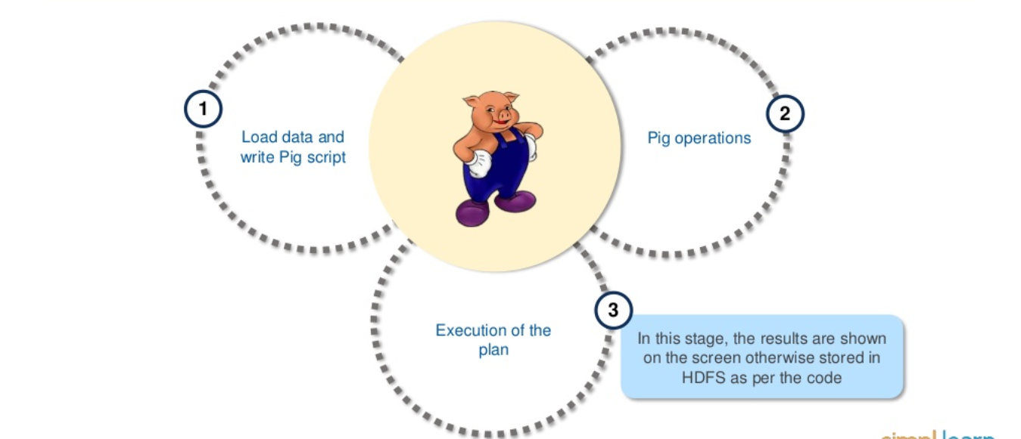
Working in Pig
Nishanth

Slide 12
Operators:
LOAD: Load data from the local file system or HDFS storage into pig
FOREACH: Generates data transformations based on columns of data
FILTER: Selects tuples from a relation based on a condition
JOIN: join the relations based on the column
ORDER BY: Sort a relation based on one or more fields
DISTINCT: Removes duplicate tuples in a relation
GROUP: Groups together the tuples with the same group key(key field)
Nishanth

Slide 13
Hive vs Pig
Hive:
Can only process structured data
SQL like query
Schema required
Connectivity to JDBC and ODBC and servers
Pig:
Process data of any data format
Schema not required
Used by developers
Nishanth

Slide 14
Advantages of Pig
Removes the need for users to tune Hadoop
Insulates users from changes in Hadoop interfaces
Increases productivity. In one test
10 lines of Pig Latin ~ 200 lines of Java
Code that takes 4 hours to write in Java, takes only 15 min in Pig Latin
Helps non-Java programmers to work on data
SaiKiran

Slide 15
Pig Usage Scenario
Web log processing
Data processing for web search platforms
Ad hoc queries across large datasets
Rapid prototyping of algorithms for large amounts of data
Who uses Pig
Yahoo, one of heaviest user of Hadoop, runs 50% of hadoop jobs in pig
Twitter is also another well known user of Pig
SaiKiran

Slide 16
Demo
Saikiran

Slide 17
References
https://www.slideshare.net/Simplilearn/pig-149037598/Simplilearn/pig-149037598
https://www.tutorialspoint.com/apache_pig/

Slide 18
Any Questions????

Slide 19
Thank You

